Slide 1
A quick glimpse through multilevel modelling
Soutrik Banerjee
1st July, 2013

Slide 2
Part I

Slide 3
Some references*
Fitzmaurice, G.M., Laird, N.M., Ware, J.H. (2004). Applied Longitudinal Analysis. New York: John Wiley & Sons.
Hedeker, D. and Gibbons, R.D. (2006). Longitudinal Data Analysis. New York: John Wiley & Sons.
Molenberghs, G. and Verbeke, G. (2005). Models for Discrete Longitudinal Data. New York: Springer-Verlag.
Verbeke, G. and Molenberghs, G. (1997). Linear Mixed Models In Practice: A SAS Oriented Approach, Lecture Notes in Statistics 126. New-York: Springer.
Verbeke, G. and Molenberghs, G. (2000). Linear Mixed Models for Longitudinal Data. Springer Series in Statistics. New-York: Springer.
Notes:
Snijders & Boskers, Diggle, Singer, etc.

Slide 4
Scenarios
When the measurements (outcomes) are not independent → i.e., they are correlated
Alternative terminologies: repeated measures data, longitudinal data, multilevel data, correlated data, hierarchical data, clustered data, panel data, ...
Models: random-effects models, mixed models, hierarchical models, multilevel models, conditional models, ...
Each cluster of observational units share some latent characteristics, but between clusters, they are sampled i.i.d.
Examples:
Asthma, eczema or rhinitis among twins (dyadic data)
Blood pressure measured over weeks among patients treated with an antihypertensive (longitudinal data)
BMI of spouses of the same household (survey data)
Pollutants’ concentrations measured in classrooms within schools within cities within countries (4-level multilevel data)

Slide 5
Comparison between cross-sectional and hierarchical models
Cross-sectional data | Hierarchical data
Linear models | Linear mixed models
Generalised linear models | Generalised linear mixed models
Non-linear models | Non-linear mixed models
- Mixed models are sometimes referred as random-effects models or mixed-effects models
- All hierarchical models are mixed models, but not vice-versa

Slide 6
Software
SAS procedures: mixed; (genmod), glimmix, nlmixed; surveyreg, surveylogistic, ...
Stata commands: xtset, xtdescribe, xtreg, xtmixed; (xtgee), xtmelogit, xtmepoisson, xtnbreg, gllamm; svy-
R libraries (packages): lme4, nlme, MASS (glmmPQL), glmmADMB, gee, geepack, ...
Also, WinBUGS, MLwiN, SPSS, SUDAAN, S-plus, HLM, ...

Slide 7
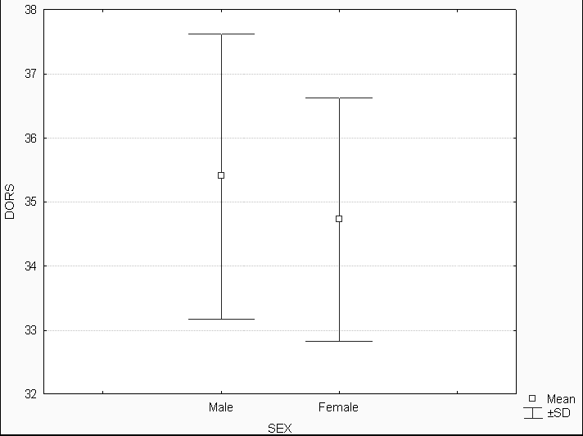
Continuous variables: a case study
Lizard data: 102 lizards (offspring)
Outcome of interest: no. of dorsal shells
Research question: is the outcome related to gender (of the offspring) ?

Slide 8
Case study: lizard data
Naive t-test (Student test) – male_{mean}: 35.4, female_{mean}: 34.7; p = 0.102, d.f. = 100 (= 102 – 2)
Non-significance could be due to between mother variability (“heterogeneity”)
Reverse finding could also have happened
The ‘problem’ is that some lizards have the same mother, i.e., 102 offspring have 29 mothers having similar characteristics related to the outcome
Mother effect might be present ??
Thus, the gender effect comparison should be based on within mother comparisons ≈ gender effect should be conditioned upon mother effect (→ gender | mother)*
Notes:
* Gender effect | mother effect – is the conditional model. Gender is fixed effect, mother is random effect here. We integrate out the random mother effect to obtain the marginal gender effect. Hence, a male offspring from a mother is considered to have a different impact from a male offspring from another mother.

Slide 9
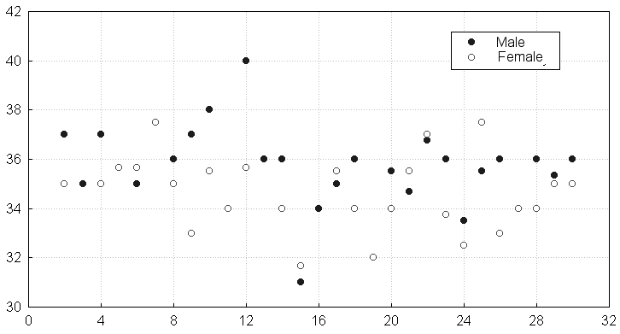
Lizard data: graphical variability*
Dors
Mothc
Between-mother variability is important (B > W ??)
Males’ values are often higher than those of females
Measurements within mothers are more alike than measurements from different mothers
Notes:
* Unbalanced dataset.

Slide 10
2-way ANOVA (1): gender, mother
Traditionally, let Y_{ijk} be the k^{th} measurement in the j^{th} gender group for the i^{th} mother
Y_{ijk} = μ + α_{i} + β_{j} + ε_{ijk} .........................................(1)
μ = overall mean
β_{j} = gender effect (= parameter of interest)
α_{i} = mother effect (too many nuisance parameters)
ε_{ijk} ~ N (0, σ²_{res})

Slide 11
2-way ANOVA (1): gender, mother
Traditionally, let Y_{ijk} be the k^{th} measurement in the j^{th} gender group for the i^{th} mother
Y_{ijk} = μ + α_{i} + β_{j} + ε_{ijk} .........................................(1)
μ = overall mean
β_{j} = gender effect (= parameter of interest)
α_{i} = mother effect (too many nuisance parameters)
ε_{ijk} ~ N (0, σ²_{res})
Alternatively#, let Y_{ij} be the j^{th} measurement on the i^{th} mother, and let x_{ij} = 0 (male), = 1 (female)
Y_{ij} = μ + α_{i} + β.x_{ij} + ε_{ij} ........................................(2)
β = average difference between males & females (= our main parameter of interest)
Notes:
# In order to better reflect the multilevel nature of the data, we will use an alternative parameterisation of the same model, with one index for each level.

Slide 12
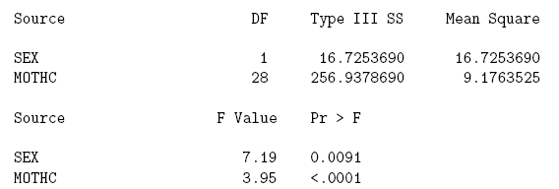
2-way ANOVA (2)
In SAS code:
PROC GLM DATA = lizard;
CLASS mothc;
MODEL dors = sex mothc;
RUN;
- Gender is now significant; also mother effect is highly significant, but the mother effect estimation ‘wastes’ a lot of degrees of freedom, which is not a parameter of interest = a ‘nuisance’ parameter
- Secondly, we are not able to study the within-group dependency in this model

Slide 13
2-way ANOVA (3)
In SAS code:
Remember to put the ‘cluster’ in the CLASS statement for REPEATED (and RANDOM) statements
PROC MIXED DATA = lizard;
CLASS mothc;
MODEL dors = sex / SOLUTION;
RANDOM mothc; * G-side (or ‘D’ matrix) parameterisation of the variance-covariance matrix;
RUN;
Also instead, REPEATED mothc; * R-side parameterisation of the variance-covariance matrix = ‘multivariate’ model ;
This above model has the same form as equation (2) with additional assumptions:
α_{i} ~ N (0, σ²_{mothc}) ..................................................................(3)
α_{i} and ε_{ij} are assumed to be independent .............................(4)
The normality assumption for the α_{i}* is natural & mathematically convenient, BUT not necessarily realistic
Notes:
* α_{i} is the random-effect (= random-intercept).
Mothers are assumed to be randomly selected from a population of mothers (wide-space inference).

Slide 14
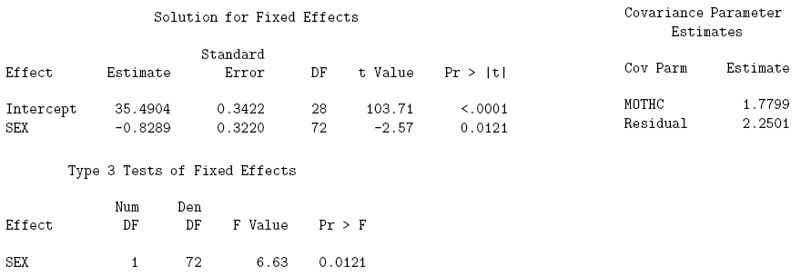
2-way ANOVA (4)
Note now the significant difference between males and females; p = 0.012
Whilst with t-test, ignoring the mother effect, p = 0.102
σ²_{mothc} = variability between mothers = 1.78
σ²_{res} = variability within mothers = 2.25

Slide 15
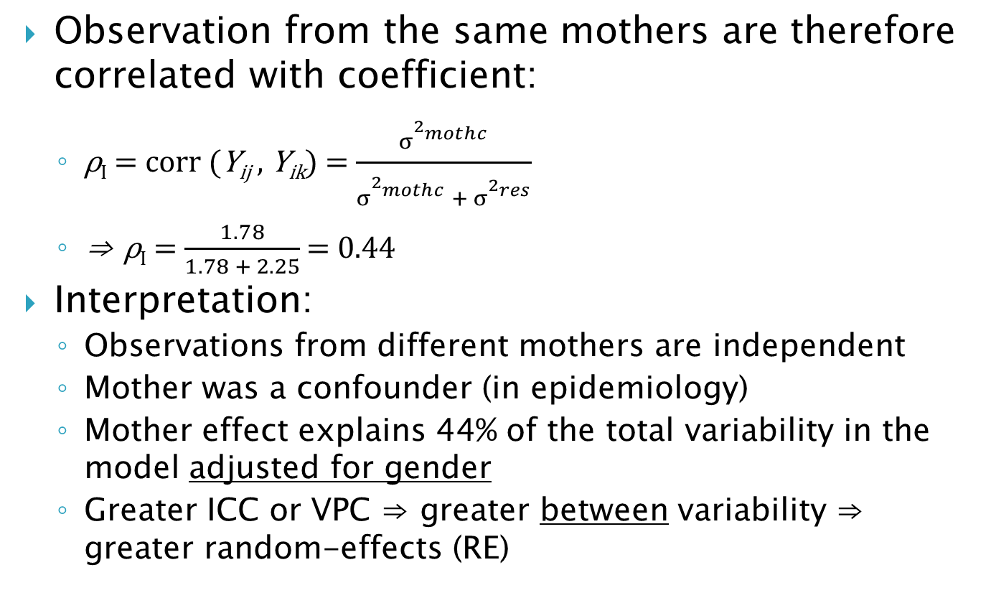
Intra-class correlation (ρ_{I}) or variance partition coefficient (VPC): 2-level model
Observation from the same mothers are therefore correlated with coefficient:
ρ_{I} = corr (Y_{ij} , Y_{ik}) = $\frac{σ_{}^{2_{mothc}^{}}}{σ_{}^{2_{mothc}^{}} + σ_{}^{2_{res}^{}}}$
⇒ ρ_{I} = $\frac{1.78}{1.78 + 2.25}$ = 0.44
Interpretation:
Observations from different mothers are independent
Mother was a confounder (in epidemiology)
Mother effect explains 44% of the total variability in the model adjusted for gender
Greater ICC or VPC ⇒ greater between variability ⇒ greater random-effects (RE)

Slide 16
Hierarchical vs. marginal LMM* (1)
This relatively ‘simple’ hierarchical model can be written in the form:
Y_{ij} |α_{i} ~ N (μ + α_{i} + β.x_{ij} , σ²_{res}), Y_{ij} conditionally independent given REs
α_{i} ~ N (0, σ²_{mothc}), independent
cov(σ²_{res} , σ²_{mothc}) = 0, from equation (4)
Each of the above equation corresponds to one level in the multilevel data structure
This model is therefore called hierarchical model = conditional model
One might extend this model (a 2-level random-intercept model) to more levels (nested, crossed REs) or use random-coefficients (variance changing over time) or add serial or spatial correlations, ...
Notes:
Random-intercept model: REs are denoted by different notations: alpha, b, u depending on textbooks.

Slide 17
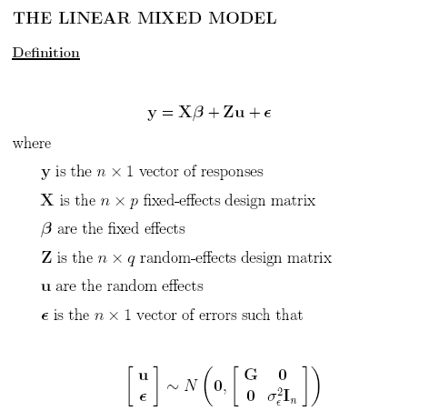
(p x 1 design matrix)
(q x 1 design matrix)

Slide 18
Hierarchical vs. marginal model (2)
Marginal estimates = population-averaged estimates
Interpretation: compares (i.e., difference or ratio) groups having to not having a characteristic
The within-cluster correlation is treated as a ‘nuissance’
Analogy with conditional logistic regression
Conditional estimates = subject-specific estimates
Interpretation: compares individuals having to not having a characteristic
The within-cluster correlation is conditioned upon ⇒ this dependence is modelled in a variance-covariance matrix

Slide 19
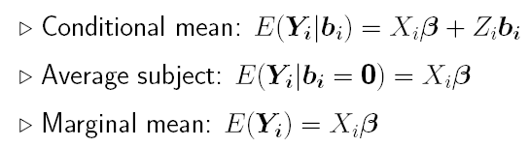
Hierarchical vs. marginal model (3)
In linear mixed model (LMM) context, both estimates are same, but not so in case of non-Gaussian outcomes !
LMM: hierarchical model ⇒ marginal model (estimates are the same)
Average evolution (marginal) = evolution of ‘average’ subject (conditional)

Slide 20
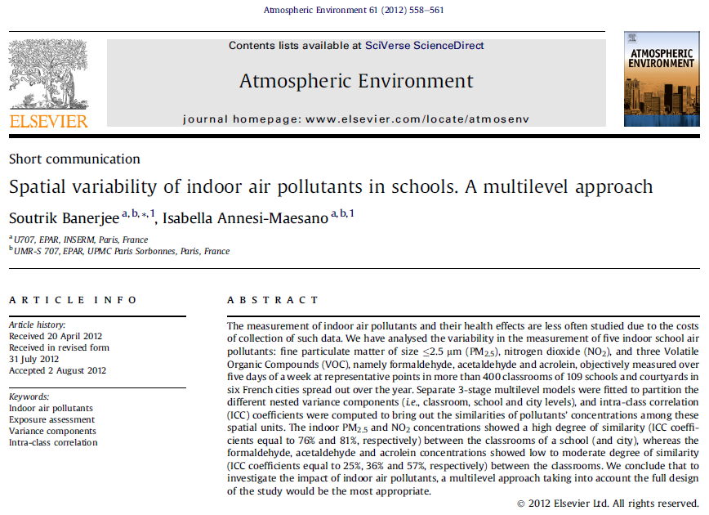

Slide 21
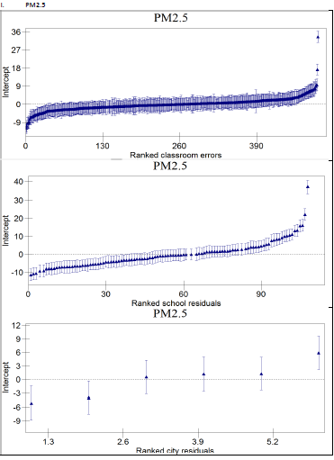

Slide 22
Part II

Slide 23
Non-Gaussian outcomes (1)
Generalised Estimating Equations (GEE) through GENMOD procedure (SAS), xtgee (Stata)
Only marginal (ℛ-side) estimates are produced by method of moments assuming a working correlation matrix (TYPE = IND, EXCH, AR(1), UN are currently available in SAS)
It gives quasi-likelihood estimates; so cannot be used for model comparison
Always use robust, ‘sandwich’ estimates
It is stable to missing data (although, only MCAR assumption is valid for GEE*); works well when the no. of measurements (n_{i}) in a cluster are few (up to 4)
Roughly >200 observations (N) are needed for valid inferences (i.e., Normality assumption of the betas)
Model convergence is rapid
Cf. Prentice GEE; Alternating Logistic Regression (ALR) (SAS)
Notes:
* WGEE is valid for MAR assumption

Slide 24
Non-Gaussian outcomes (2)*
Linearisation-based method (Penalised Quasi-Likelihood (PQL)) through GLIMMIX procedure (SAS), glmmPQL (R)
Both marginal & subject-specific (both ℛ-side & ℊ-side) estimates can be produced by 1st order Taylor expansion (PQL1); Cf. PQL2 (better); MQL1, MQL2 (not very good)
It gives pseudo-likelihood estimates; so cannot be used for model comparison
Works better (less bias) when the outcome distribution is closer to normal, e.g., Poisson distribution is preferred to binary
Can be used as starting estimates for Adaptive Gauss-Hermite Quadrature-based (= numerical) methods (cf. later)
Model convergence is rapid (be careful to ↑ max (default = 20) no. of iterations in SAS !)
REML fitting is allowed; also 3 levels of REs can be specified in SAS ~ Normal distribution only
Robust estimates are produced by EMPIRICAL SAS option,
_RESIDUAL_ in RANDOM statement in SAS gives ℛ-side estimates
Notes:
* Stata doesn’t use this, but SAS & R does.
GLIMMIX can be used for spatial smoothing, mixed bivariate distributions (e.g., Poisson with binomial), random-splines.
EMPIRICAL option conflicts with DDFM option.

Slide 25
Non-Gaussian outcomes (3)
Numerical integration (non-adaptive, adaptive (default in SAS) methods) through NLMIXED procedure (SAS), and xtmelogit, xtmepoisson, gllamm (Stata)
More accurate, but only gives model-based (not robust) full ML (not REML) subject-specific (ℊ-side) estimates in SAS
Only conditional estimates are produced
Model convergence is slow depending upon the no. of quad. points in SAS, gllamm
Stata, by default, uses 7 (xtme) or 8 (gllamm) quad. points
Be careful to ↑ max (default = 20) no. of iterations in SAS !
Records with missing values must be removed a priori in SAS
Using no. of quad. points = 1 implies Laplace approximation (SAS default)
SAS permits model fitting with different distributions, which can be specified (binary, Poisson, negative binomial, gamma, beta, t, ...) by writing out the full log-likelihood in SAS
SAS allows only 1 level of REs ~ Normal distribution only

Slide 26
Some useful points to remember (1)
Model fitting (in LMM):
First, fit the best covariance structure using REML SAS option
Next, fit the best mean structure using ML option, which can compares the means, but are biased
So finally, re-estimate the final model again with REML option
Degrees of freedom:
The default containment or BW method is not very good
So, use Satterthwaite or Kenward-Roger method
Data:
Arranged / stacked / reshaped ‘vertically’ or in the ‘long’ form instead of ‘horizontally’ or in the ‘wide’ form
↑ N will increase statistical power, but ↑ n_{i} will not impact power
In binary outcomes, ↑ no. of events will ↑ statistical power
In SAS, use DESCENDING option for outcome coded 1/0. In Stata, this is not needed.

Slide 27
Some useful points to remember (2)
Random-effects:
Fixed-effects (FE): parameters are fixed (±95% CI), data are a random sample (frequentist’s view)
Random-effects (RE): the factors are believed to come from a distribution ~ i.i.d. (often N.i.d.) meaning parameters have a distribution (Bayesian’s view)
REs are latent unmeasured variables, which we estimate through ‘our’ model ⇏ random variability observed in the distribution of Y_{ij}

Slide 28
Some useful points to remember (3)
Random-effects:
Inclusion of REs may (not) affect the estimation of other FEs, but often has important impact on their estimated standard errors (SE):
E.g., may ↑ SEs for between-cluster effects (β₀) ⇒ ↓ statistical power for between-cluster effects
E.g., may ↓ SEs for within-cluster effects (β₁.time) ⇒ ↑ statistical power for within-cluster effects, which is what we want
Misspecification (e.g., non-normality) of REs:
Inferences (SEs) about FEs are robust if N is sufficiently large in random-intercept models!
Bayesian Empirical Bayes (EB) estimates* (SAS) can be used to check for REs’ posterior distribution
Achtung: Normality of EB estimates cannot be used to confirm / check Normality !
Notes:
* Expected REs, conditionally on the observed data for that specific cluster

Slide 29
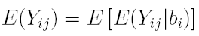
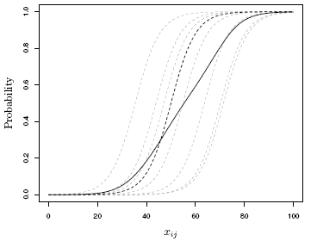

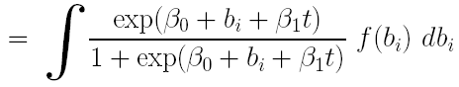
Marginal estimates vs. evolution of ‘average’ subjects*
← GEE ↑
AGHQ
Notes:
* b_{j} are random-intercepts, with mean 0 and variance phi.
The logistic function is f (Y_{i} | b_{i}).
Stronger the REs, greater will be the slopes of the subject-specific model compared to the slope of the marginal model.
The integration can be achieved by numerical (adaptive Gauss-Hermite quadrature or non-adaptive) or MCMC sampling.

Slide 30
Further aspects
Bayesian shrinkage (EB) estimates
Model improvement:
Longitudinal: adding random-coefficients (random-slopes)
Multilevel: adding different levels
Spatial: adding spatial structure into the covariance
Considering different covariance structure (ℛ-side)
Considering non-normal, mixture distribution for random-effects
Model goodness of fit (GoF):
Visual
Formal tests
Inference for covariance parameters
Mixed Χ² distribution
Misspecification of REs
Sample size and power calculations in cluster data:
Within-cluster +ve correlation increases power for within-cluster effects
Cluster sampling with –ve ICC increases power, but +ve ICC decreases power in a survey setting
MCMC ‘integration’ in place of numerical integration

Slide 31
Thank you !

